Slide 1
Competitive Analysis: Portfolio
Jeongho Cho
A97419559
COGS 187A

Slide 2
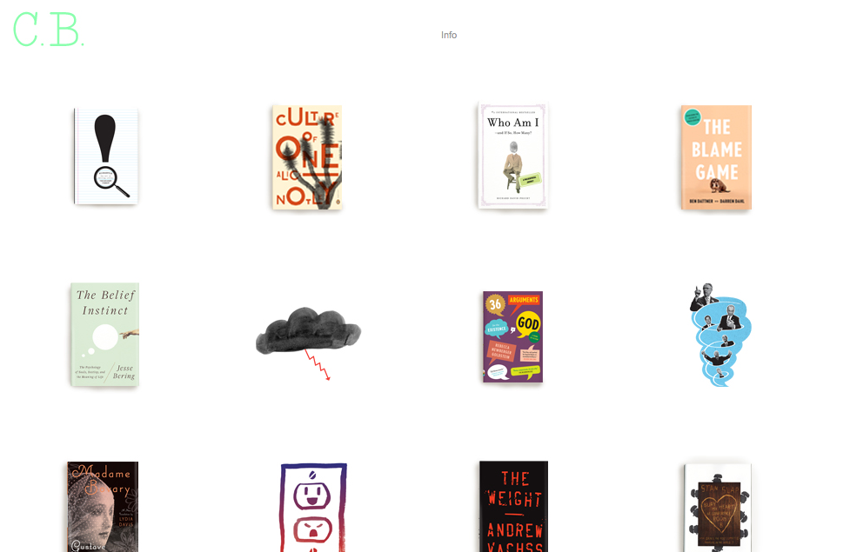
Site #1 C.B.

Slide 3
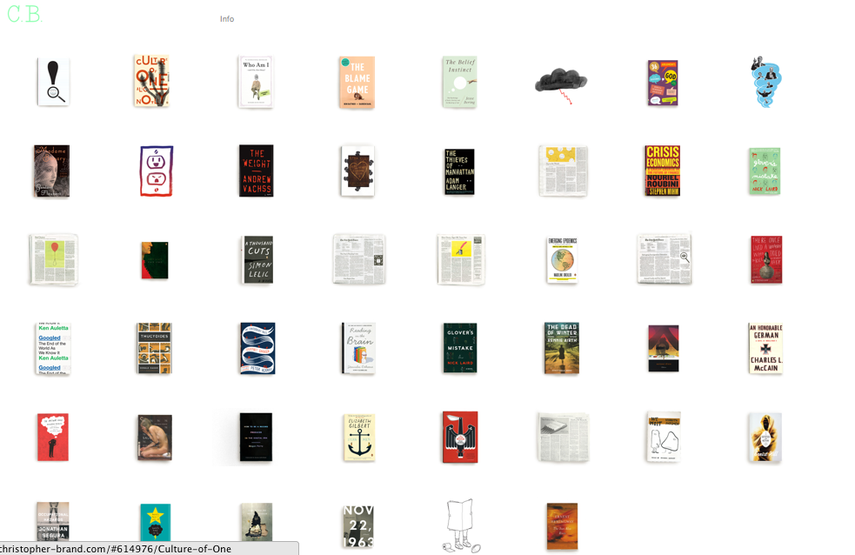

Slide 4
C.B.
URL: www.christopher-brand.com
Date of looked: 1.19.2012
Brand | the glance of this site is fun, childish and interesting. The main page is full of images, which are mostly covers of books or newspapers. Since there is no explanations or information of soring, it’s even more interesting.
Functionality | There is no secondary pages, yet the only the main page. However, when one of photos is clicked, the page puts the photo on the top of the main page, plus, gives a little bit of information about the photo. In addition, when you click the ‘info’ button, you will the information about the site on top of the site.
Interactivity | There is no categorize or sorting in the site.
Navigation | No navigation part in either header or footer. When you want to go different page, you will need to scroll down, and click another photo, or click the logo.

Slide 5
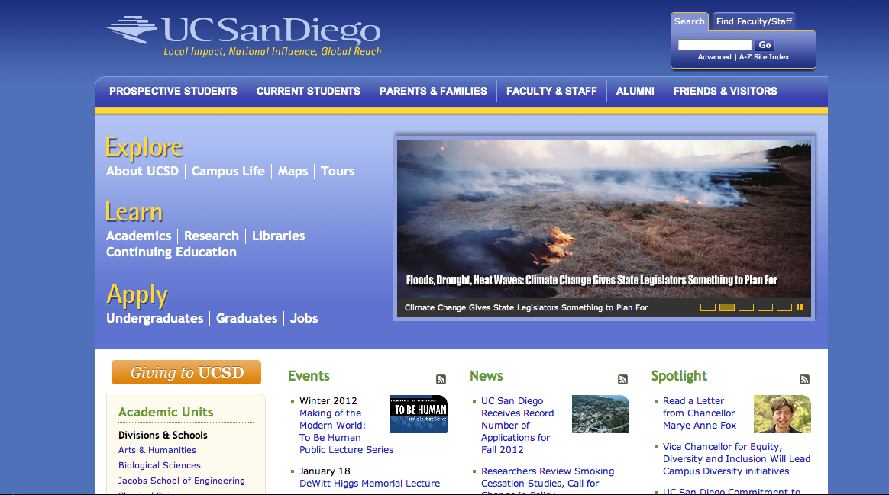
Site #2. UCSD

Slide 6
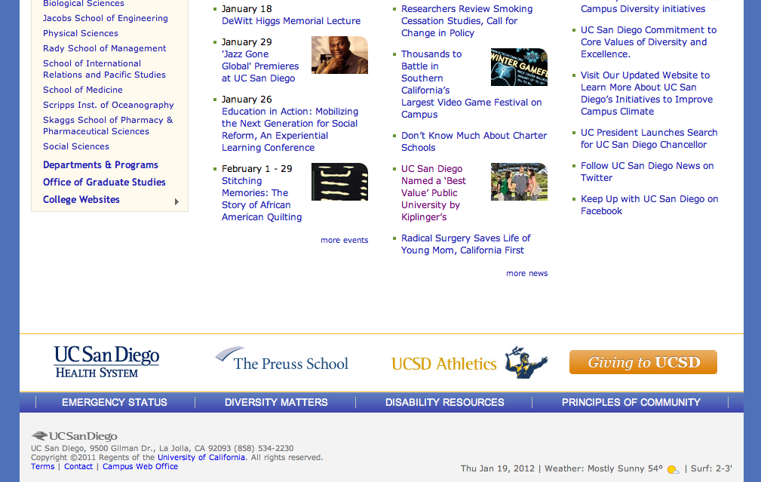

Slide 7
UCSD
URL: www.ucsd.edu
Date of looked: 1.19.2012
Brand | The site is very much professional, academic, and very practical, because it has a lot of information on the main page. Plus, the site is very well organized in many specified categories, so that viewer or users can find what they want easily.
Functionality | In the main page, there are number of buttons viewer can click and move into secondary pages, and if it is necessary viewer can click buttons on sub-menu in order to move to the information they want. Since there are fairly enough secondary pages under the main page, and it shows very detail and specific information so that viewer do not need to worry if they see what they need to see.
Interactivity | They do not use cover flow, yet they have slid show like thing in the middle of the main page, which gives information about events or highlighted news.
Navigation | The website seems it does not have the navigation bar either on header or footer but it has a search bar and site index on the right top corner. If you are in secondary pages, you will need to click the logo or click the back space to go back to previous page since the main page sent you to sub-pages.

Slide 8
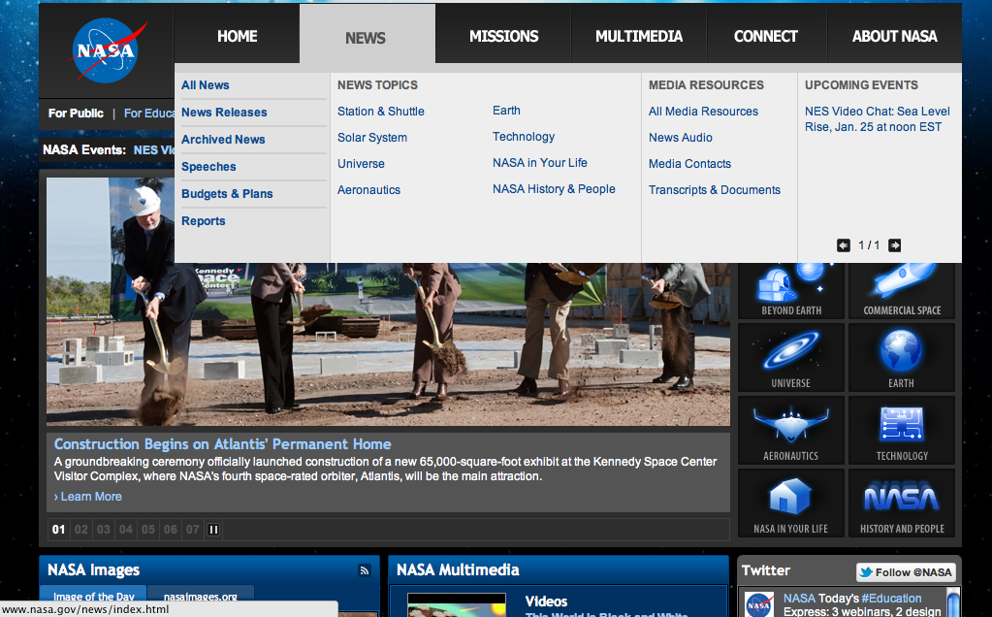
Site #3 NASA

Slide 9
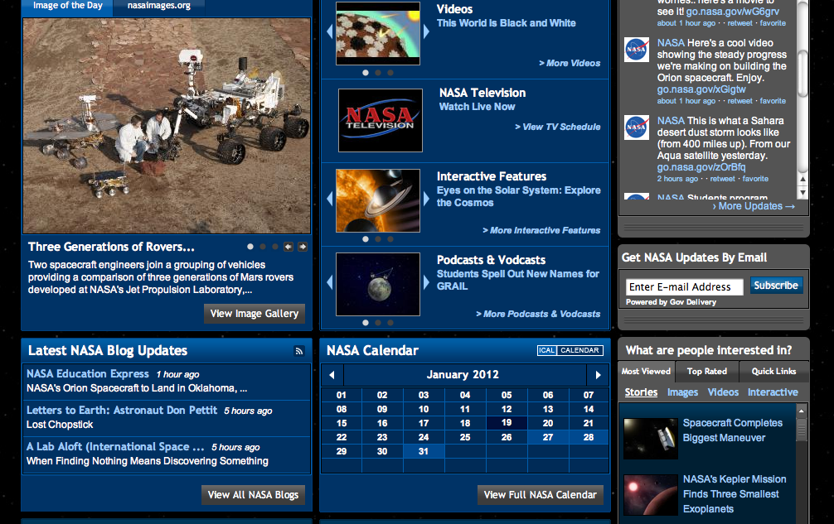
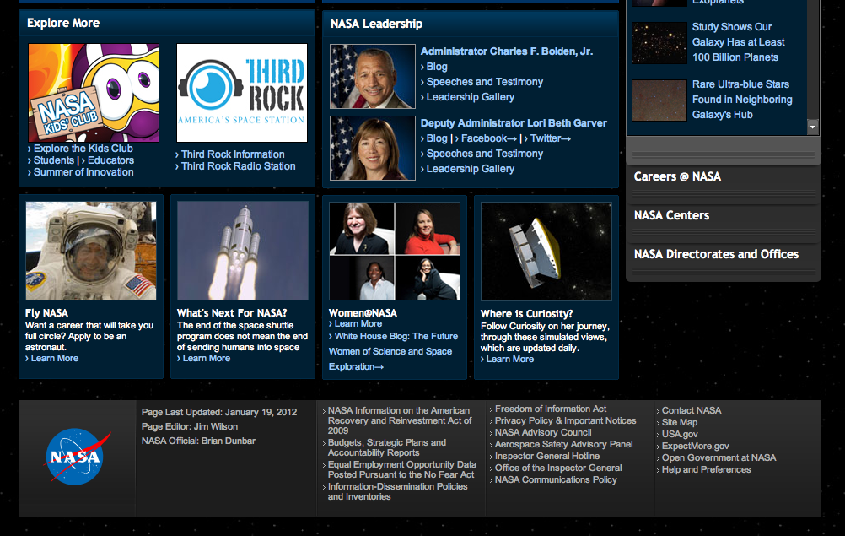

Slide 10
NASA
URL: www.nasa.gov
Date of looked: 1.19.2012
Brand | The site looks very professional, yet it is interesting at the same time. Since the site is a scientific government organization’s, it could be boring and heavy with a lot of formal and dry stuff, yet the site use cute icons and buttons, the site is not as boring as I thought
Functionality | The site is very well organized and has a lot of secondary pages . I can see all the details in the site by moving menu button to another.
Interactivity | They don’t use cover flow or light box, but used video player and many of slide like thing to show information. No sorting is allowed in the page.
Navigation | Do not have a typical styled navigation in footer, yet there is a site map button. When you click that it shows 9 different categories and sub menus so that you can move easily. When you are in ‘a’ part you can see exactly where you at since there is a table menu on the left side of the body.

Slide 11
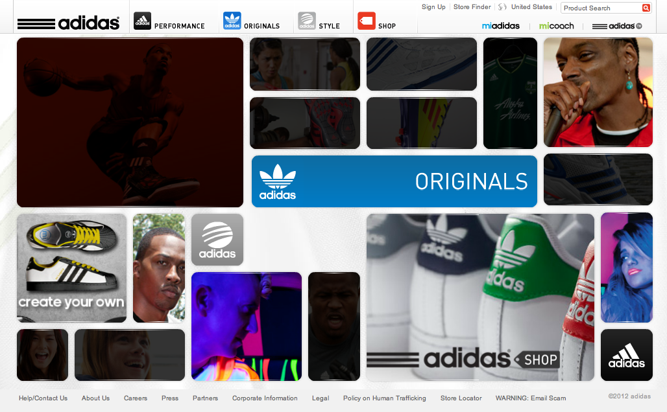
Site #4 ADIDAS

Slide 12
Adidas
URL: www.adidas.com
Date of looked: 1.19.2012
Headline and Gallery
Brand | The site is very interesting, fun, and childish. In the main page, you will see bunch of different images and when you move your mouse cursor on images, shape of the image changes and gives you some information. That is also a menu button that you can move to sub categories.
Functionality | It shows exactly what I wanted to see. Very easy to reach to where I wanted to and the main page connect viewer to it’s sub pages, which are opened on another tap.
Interactivity | It uses some kind of light box It sorted as sex, style, and age, so that viewer can easily find what they need.
Navigation | There is no navigation, but the main page work as a navigation. And when you are in the sub-page, you can always go back to the main by switching tab.

Slide 13

Site #5 GUCCI

Slide 14
Gucci
URL: www.gucci.com/
Date of looked: 1.19.2012
Featured Photo
Brand | The site is very luxury, smooth, and classy. The main page is made up with header menu, and light box like flash menu. When you click one of three button, some images comes out, but the image come out as fast as any other site. They comes out very slowly and smoothly so that viewer might think it is classy.
Functionality | The site looks it does not have many menus, yet there are many menus, and subcategories. In addition, there are some kind of symbolic images, viewer can move easily.
Interactivity | I do not think they used cover flow, but they use the light box. When viewer click an image of their goods, the lightbox comes out and gives detailed information.
Navigation | No typical type of navigation, but header menu has all branches, so viewer do not need to worry about their location. Plus, at any page of the web, viewer can move out to main or move to another category easily by clicking the buttons.

Slide 15
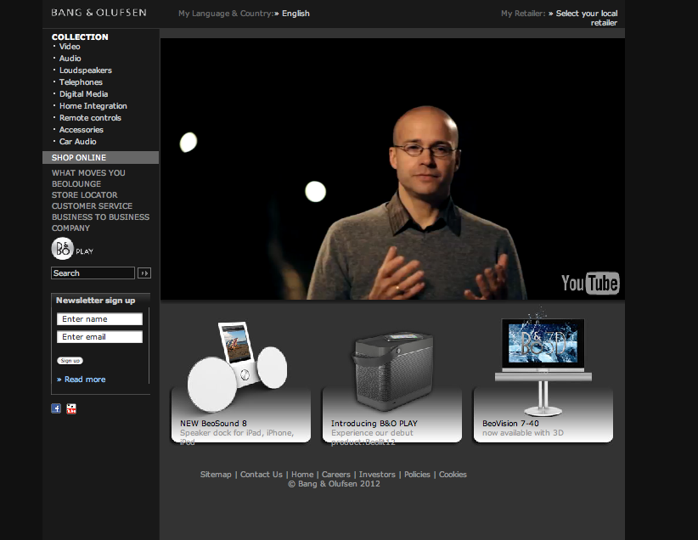
Site #6 Bang & Olufsen

Slide 16
Bang & Olufsen
URL: www.bang-olufsen.com/
Date of looked: 1.19.2012
Fixed Slider
Brand | The website is pretty interesting, and fun because there is a video player in the middle top of the main page. In the video, presenter is explain how good their products are. Plus, the main site is very simple, all the menus are placed on left hand side, and when viewer clicks it images come out in the middle of the main page.
Functionality | It is very effectively shows what I want to see, since the menus are spread when I click it and the slide shows come out so that viewers can have more information about the products. The site has enough number of secondary pages so people can see exactly what they want.
Interactivity | There are no cover flow or light box, but has lots of slide shows, and the slide shows are pretty interesting. the menu are well categorized by their functions such as speakers, loud speakers, and telephones, so that viewer can find their needs within a seconds
Navigation | No typical type of navigations, but since the site is pretty simple, navigation is not necessarily required.

Slide 17
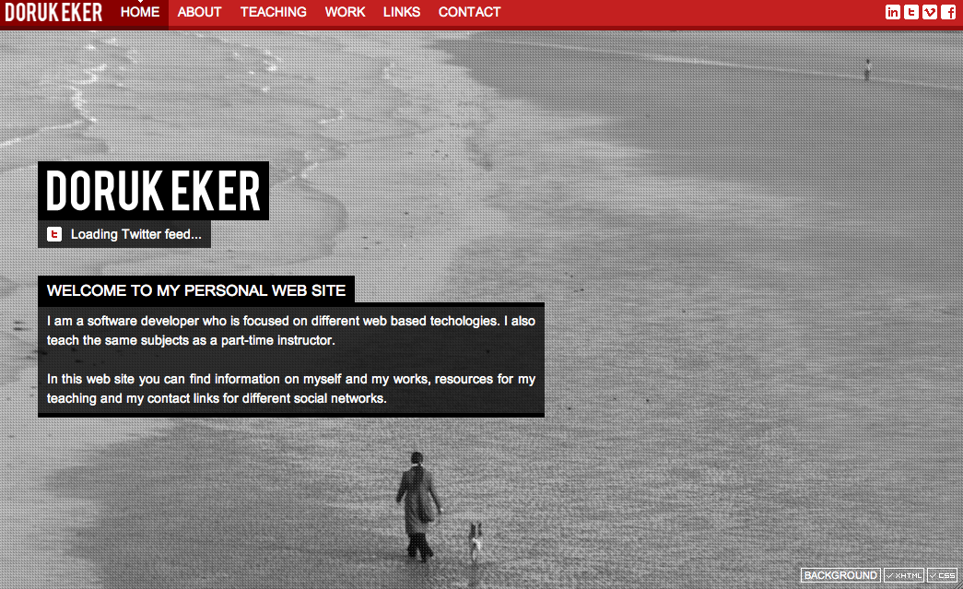
Site #7 Doruk Eker

Slide 18
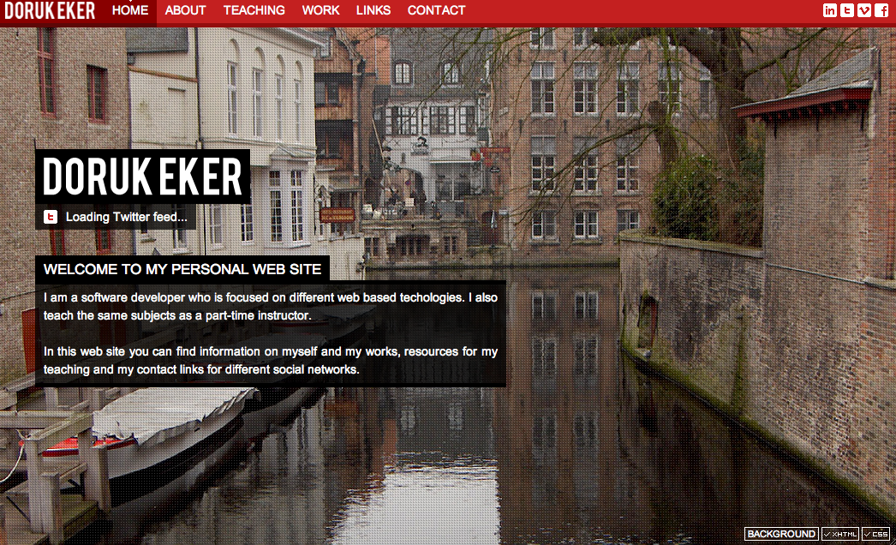

Slide 19
Doruk Eker
URL: www.dorukeker.com/
Date of looked: 1.19.2012
Full Screen Photo
Brand | Simple, interesting, but nothing. This is personal website of software developer. The site is full of photos of landscape, which are changed when reloaded, so it is interesting. Since there is not many things on the main age, it is very simple. However, it is kind of boring since there is not many things to do, get or read.
Functionality | It only gives a little bit of information about the person, what the person does, what the person has done, and some links, so there are not so many things to give details. As well as no secondary pages.
Interactivity | No light box, no cover flow or slide shows.
Navigation | There is only one main menu on the top of the site, which works as navigation.

Slide 20
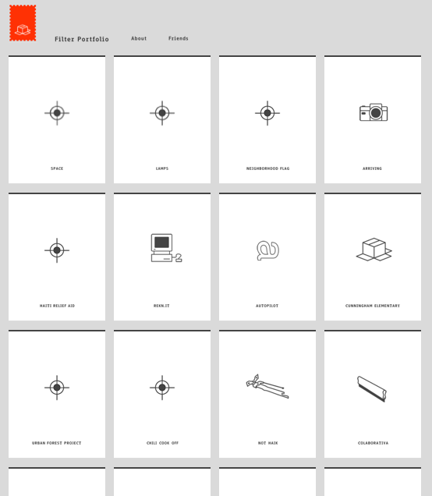
Site #8 Haikavanian

Slide 21
HAICAVANIAN
URL: www.haicavanian.com
Date of looked: 1.19.2012
Headline and Gallery
Brand | The site is very simple, fun, and childish. The format is headline and gallery. The pictures are very simple with a symbols and a word. The interesting thing is that the pictures are changed to different pictures when the cursor is placed over them. Plus, the logo, which is on the top left hand side is the only color thing, it has strong impact.
Functionality | It does not look like it effectively shows what it need to be shown. There are only couple of pictures in sub-pages. When viewer click a button and go into secondary page, there is pictures and some words, which I can not understand.
Interactivity | No cover flow, no light box. But the changing pictures are really interesting, and the way they design the site is really cool.
Navigation | No typical style of navigation, and viewer never know where he/she is on the site, because of lack of categorizing. But viewer always can go back to previous page by clicking logo.

Slide 22
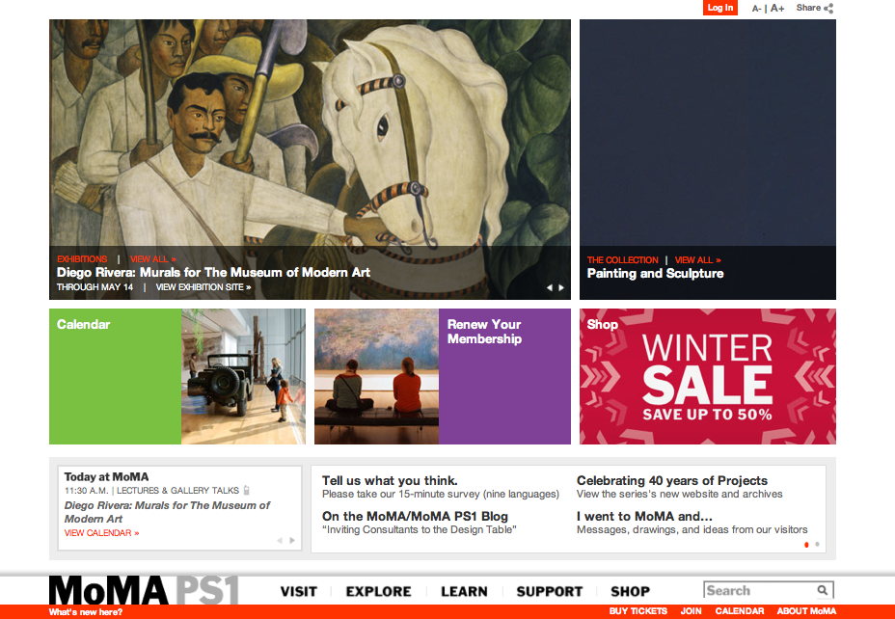
Site #9 MOMA

Slide 23
MOMA
URL: www.moma.org
Date of looked: 1.19.2012
Brand | Very simple, but interesting because they put a slide show on the top of the main page. In addition, the menu is placed at very bottom of the site, which is pretty interesting point. The logo is also at the very bottom, so viewer may not notice that is a logo before turn the main page to sub-page. For me it is all new style webpage.
Functionality | It is very effectively shows what I want to see. Plus, the site has enough number of secondary pages so people can see exactly what they want.
Interactivity | No cover flow, but there are number of slide shows that shows pictures or gives information of events. The site is very well organized sorting by chractreristics.
Navigation | On the left top, there is a navigator that shows where the viewer is from the very top menu to where the viewer see.

Slide 24
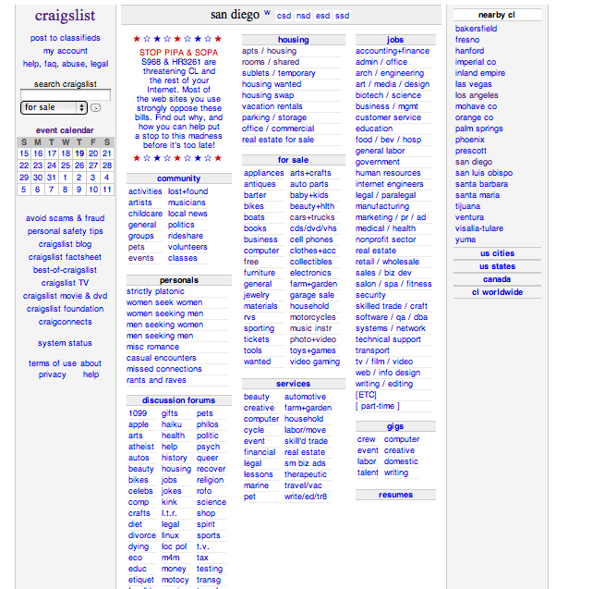
Site #10 Craigslist

Slide 25
Craigslist
URL: www.craigslist.org
Date of looked: 1.19.2012
Brand | The site is very boring, tired, yet looks like it is very effective since there is no stuff other than information.
Functionality | It exactly shows what It need to be shown. If I click the house category, it shows secondary page regarding house, and gives some sub-categories to check such as room & share.
Interactivity | The site is very simply categorized by topics.
Navigation | The main page itself is like a navigation. Plus, wherever you are, it shows your location on the top left hand side.

